Slide 1
Naive Bayes Machine Learning Model
By Amrita Panjwani

Slide 2
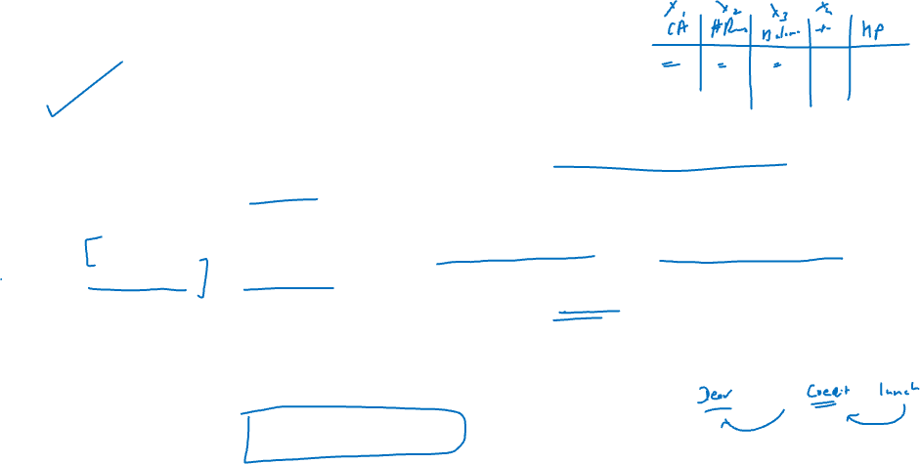
Naïve Bayes Algorithm
As the name goes this model is based on the Bayes Probability Theorem.
It is labeled as ‘Naïve’ because of the assumption based on which this model works.
This model assumes that all the predictor variables are not related to each other at all. In real world, when we work with several variables, they do have some relation. Hence the assumption is naïve!
But there are many Use Cases where we have found this assumption to hold true. Text analysis & Sentiment analysis find strong relevance of Naïve Bayes Model.
It is originally a classification model.

Slide 3

Advantages of NB Model
Since it is based on probability it is easy to follow.
It is one of the fastest working models on complex datasets
It is scalable.

Slide 4
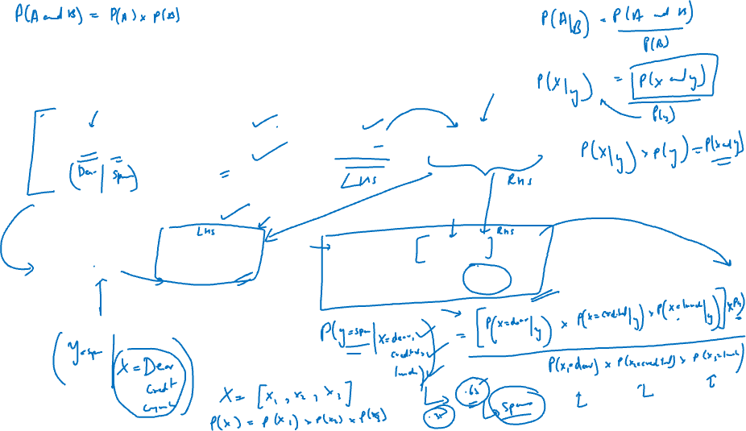
Conditional probability

Slide 5
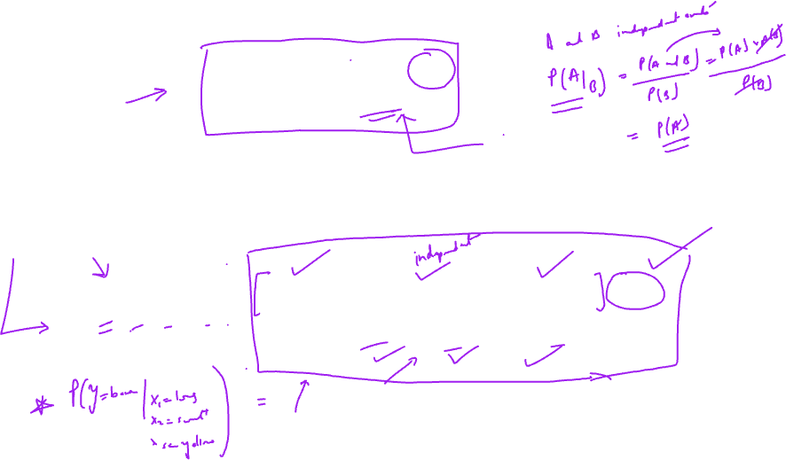
Since there are different independent variables like X1, X2 and so on… we can rewrite the above equation as:

Slide 6
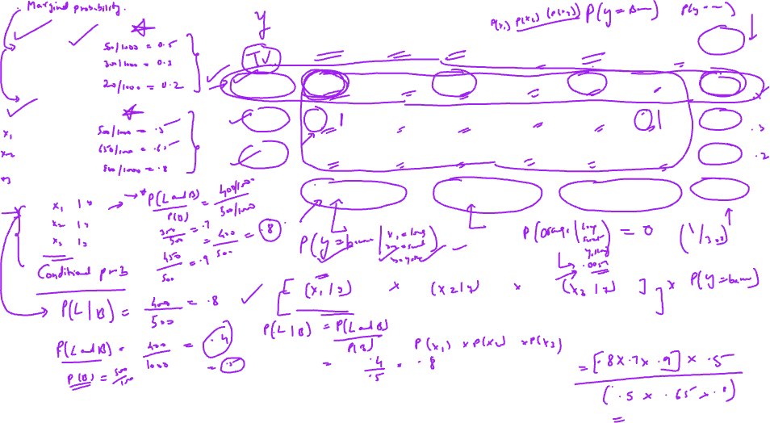
Step I:
P(Banana) =
P(Orange) =
P( Others) =
Type | Long | Not long | Sweet | Not sweet | Yellow | Not Yellow | Total
Banana | 400 | 100 | 350 | 150 | 450 | 50 | 500
Orange | 0 | 300 | 150 | 150 | 300 | 0 | 300
Others | 100 | 100 | 150 | 50 | 50 | 150 | 200
Total | 500 | 500 | 650 | 350 | 800 | 200 | 1000
Step II:
P( Long) =
P(Sweet) =
P( Yellow) =
Step III:
P( Long | Banana) =
P(Sweet | Banana) =
P( Yellow | Banana) =
Step IV: P(Banana | long, sweet, yellow) =
In this way the probability of class ‘BANANA’ can be calculated.
In the same way the probability of ‘Orange’ and ‘Others’ can also be calculated.

Slide 7
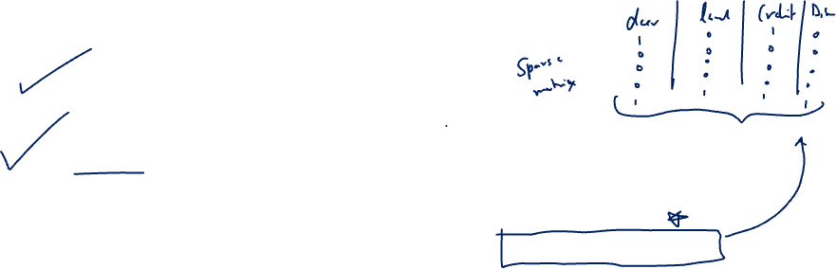
Two drawbacks
Problem of ‘Zero Frequency’: If we look at P(Long | Orange) , it turns out to be zero.
This will give the class probability zero.
This is one of the flaws of Naïve Bayes Theorem.
In order to address this flaw, Naïve Bayes uses Laplace’s Correction.
Replace 0 by 1 in the entire table so that some idea about probability of each class can be obtained. This goes internally in the algorithm and accordingly the probability of each class is evaluated.
Problem of correlation: If there are any correlated predictor variables, it is important to remove such variables or merge such features so that the assumption of Naïve Bayes is valid.

Slide 8
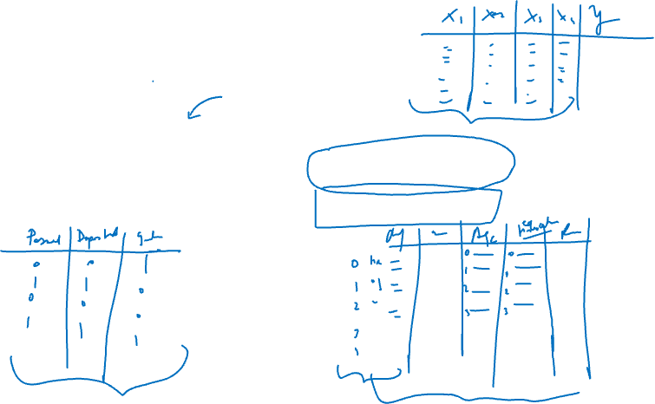
Classifiers
If data is continuous: Gaussian classifier is used
If the data has more than 2 categories: Multinomial classifier is used
If the data has all variables as bivariate: Bernoulli classifier is used

